Slide 1

Hacking
&
Cyber Crimes...

Slide 2

Invisible Criminals are far more Dangerous than the Visible ones...

Slide 3

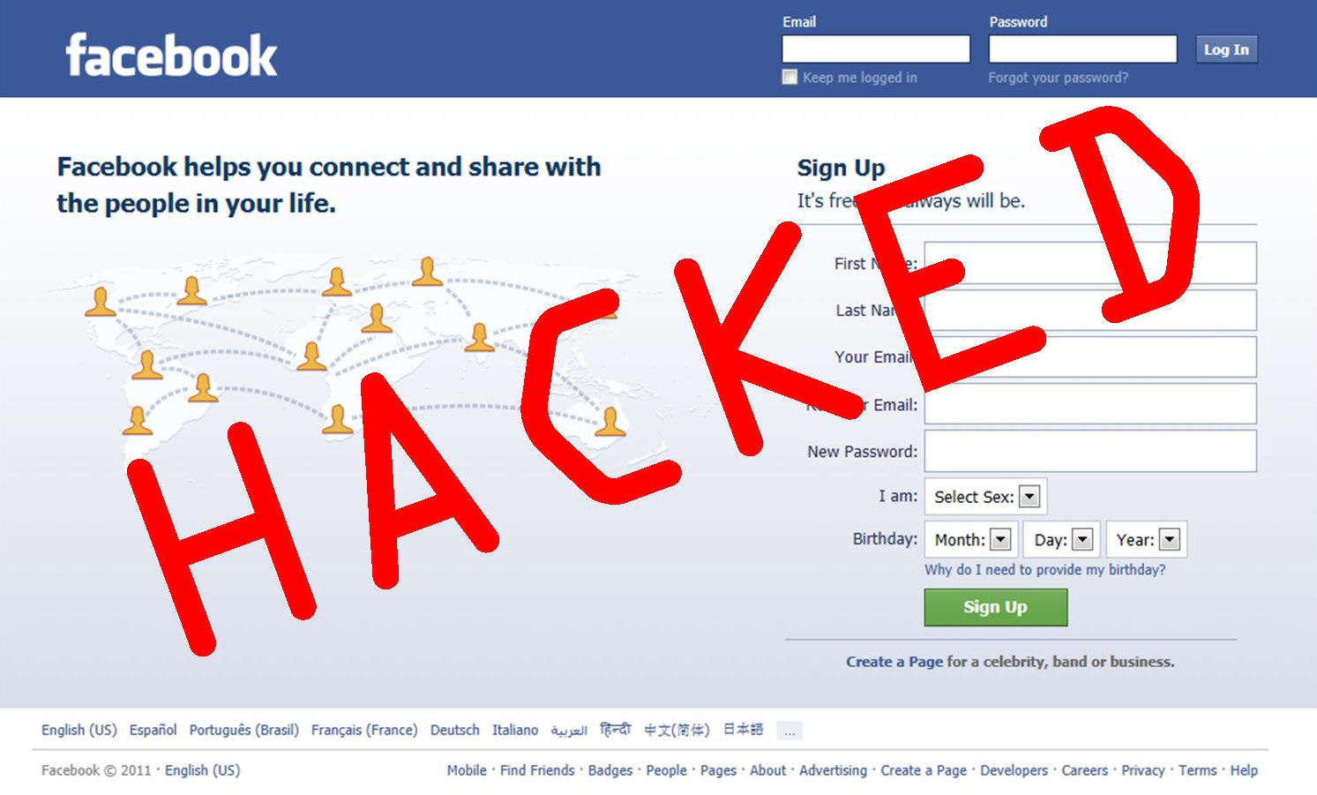

Hacking...
Hacking is the practice of modifying the features of a system, in order to accomplish a goal outside of the creator's original purpose...

Slide 4

What do Hackers Do?

Slide 5
Types Of Hackers...
White hat Hackers
A “white hat” hacker breaks security for non-malicious reasons, perhaps to test their own security system or while working for a security company which makes security software.
Black hat Hackers
A "black hat" hacker is a hacker who "violates computer security for little reason beyond maliciousness or for personal gain"

Slide 6

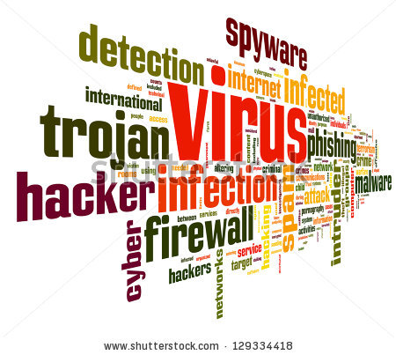
Some Dangerous Viruses...
Trojan Horse
Melissa
Nimda (~admiN)
Storm Worm
Stuxnet

Slide 7
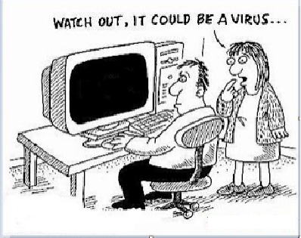


Preventive Measures...
Activate Firewalls and Anti-virus
in systems for networking
Don't Share Personal Information
in Social Networking sites...
Be Aware Of 'Phishing', dont
get into websites claiming
to give away gifts.
Be Careful while Shopping online, be
sure the websites should start with 'https://'.it means its secured.

Slide 8
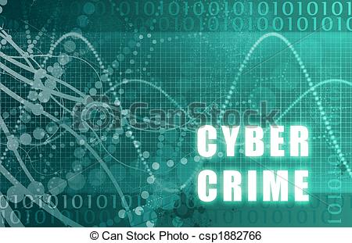
Cybercrimes...
Cyber crime encompasses any criminal act dealing with computers and networks (called hacking).
For example; hate crimes, telemarketing and Internet fraud, identity theft, and credit card account thefts are considered to be cyber crimes when the illegal activities are committed through the use of a computer and the Internet.

Slide 9




Some Dangerous Cyber Crimes
Hacking
Phishing
Identity Theft
Software Piracy
Cyber-Bullying

Slide 10
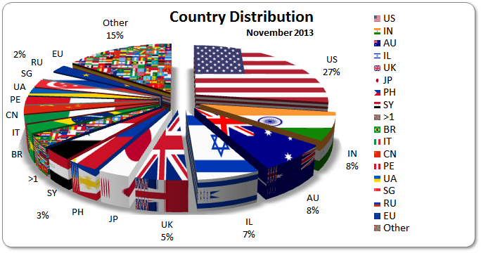
Statistics...

Slide 11
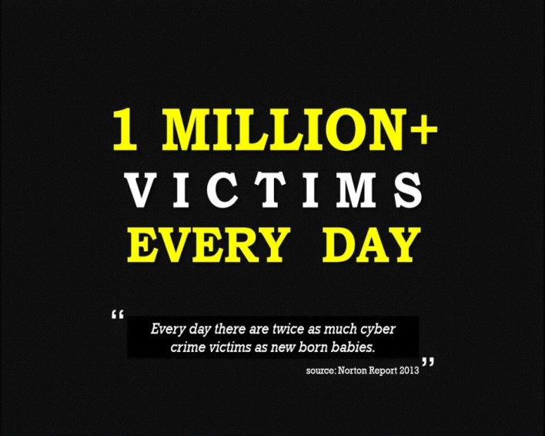
Cost Of Cyber Crime In India (2010)
29.9 million people fell victim to cybercrime.
$4 billion in direct financial losses.
$3.6 billion in time spent resolving the crime
4 in 5 online adults (80%) have been a victim of Cybercrime.
17% of adults online have experienced cybercrime on their mobile phone.

Slide 12

Be Aware
This Could Happen To You...

Slide 13

Thank U...

